Slide 1
Testing & Evaluation
20140661 신주환

Slide 2
Selecting V
1.Kaohsiung(Taiwan)
2.Seoul(Korea)
3.Jeju(Korea)
4.Kuala Lumpur(Malaysia)
5.Ulaanbaatar(Mongolia)
6.Naypyidaw(Myanmar)
7.Dhaka(Bangladesh)
8.Danang(Vietnam)
9.Hochimin(Vietnam)
10.Pyongyang(NorthKorea)
11.Toykyo(Japan)
12.Beijing(China)
13.Accra(Ghana)
14.Lagos(Nigeria)
15.Juba(South Sudan)
16.Johannesburg(Republic of South Africa)
17.Cape Town(Republic of South Africa)
18.Cairo(Egypt)
19.Nairobi(Kenya)
20.Athens(Greece)
21.Amsterdam(Netherlands)
22.Berlin(German)
23.Copenhagen(Denmark)
24.Moscow(Russia)
25.Brussels(Belgium)
26.Sofia(Bulgaria)
27.Stockholm(Sweden)
28.Geneva(Switzerland)
29.Madrid(Spain)
30.Londun(United Kingdom)
31.Praha(Czech)
32.Istanbul(Turkey)
33.Paris(France)
34.Lisbon(Portugal)
35.Helsinki(Finland)
36.Newyork(USA)
37.Washington(USA)
38.Cincinnati(USA)
39.Montreal(Canada)
40.Vancouver(Canada)
41.Santiago(Chile)
42.Rio de Janeiro(Brazil)
43.Buenos Aires(Argentina)
44.Guadalajara(Mexico)
45.Mexico City(Mexico)
46. Havana(Cuba)
47.Auckland(New Zealand)
48.Queenstown(New Zealand)
49.Melbourne(Australia)
50.Sydney(Australia)

Slide 3





Language and IDE
C++
Visual Studio

Slide 4
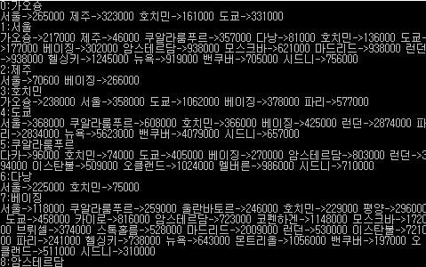
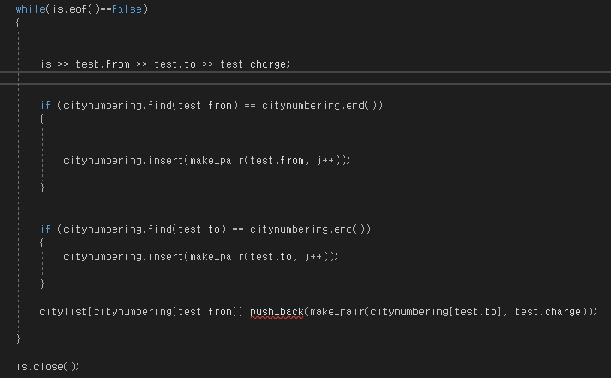
Realization Graph
Read a data line by line
City numbering with map
Save data in vector

Slide 5
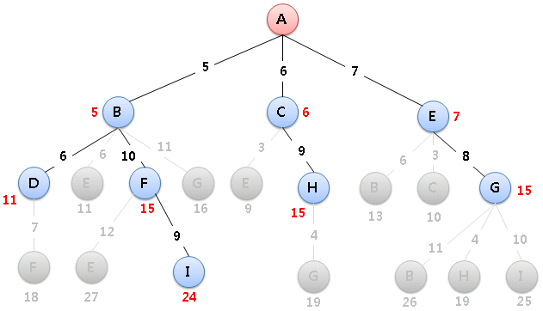
Find the least expense path
Using Dijkstra algorithm

Slide 6




Testing

Slide 7
Evaluation
Insufficient coding skills to GUI.
Collecting dataset takes too much time to complete.
Failed to code OOP.
Improved coding skills and gain a sense of accomplishment.

Slide 8
QnA

